Slide 1
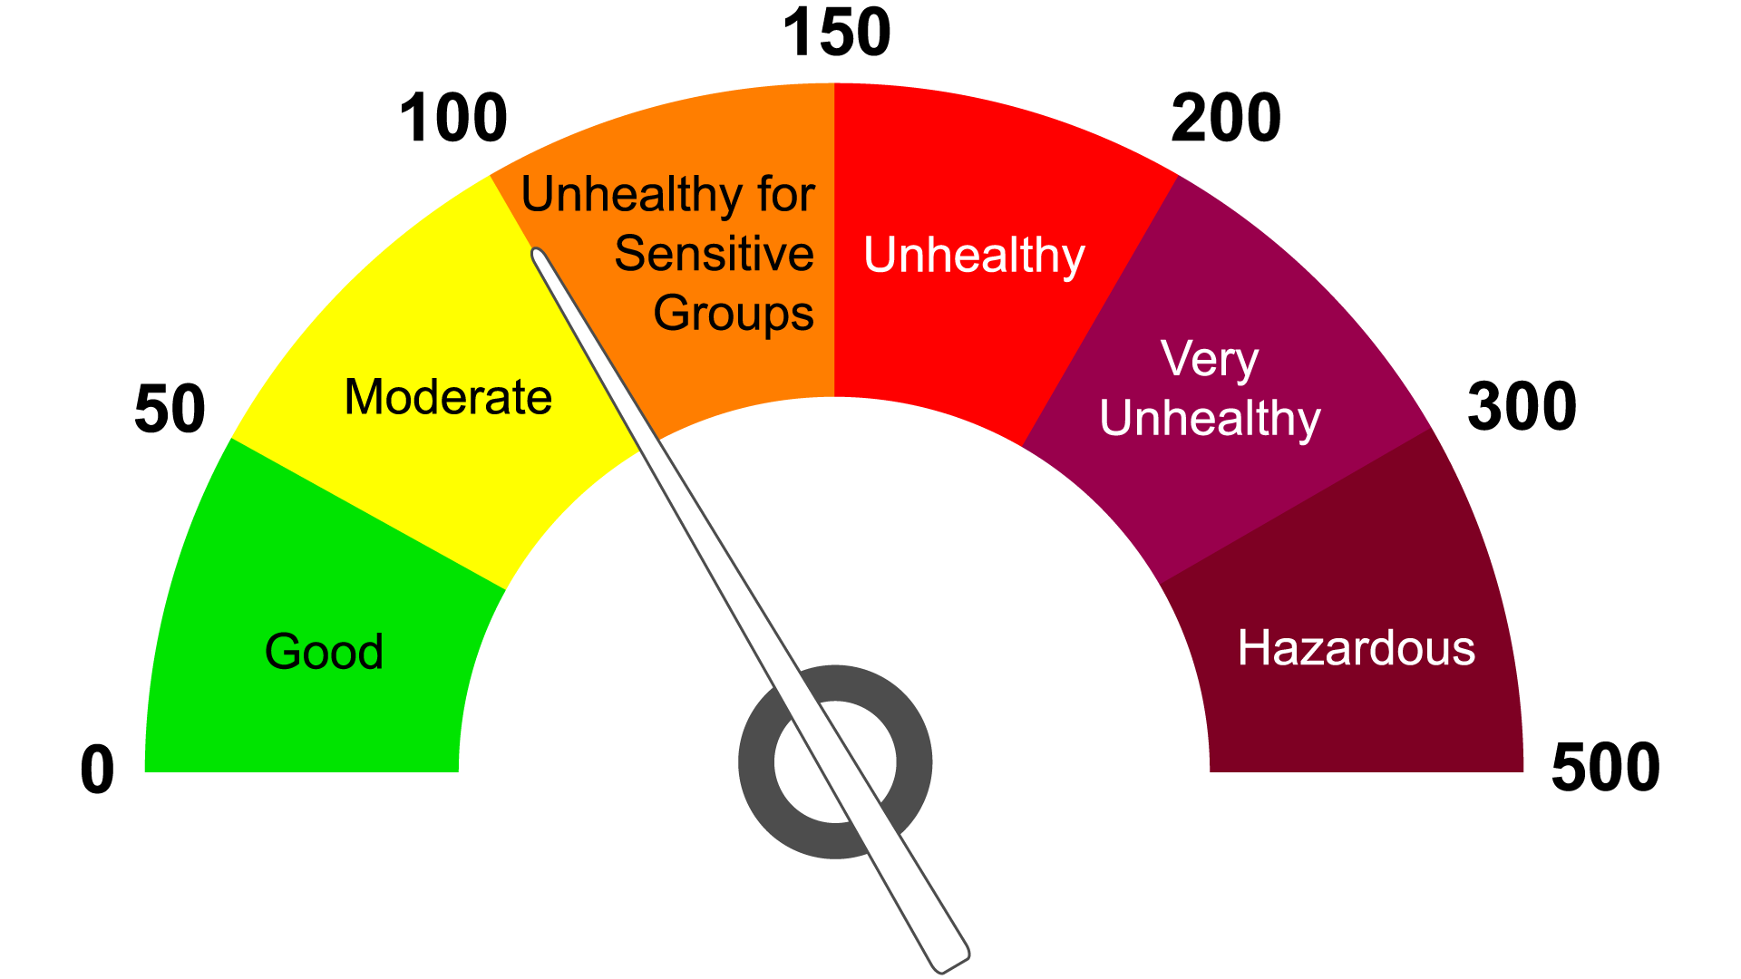
Predicting St. Louis’
Air Quality Index
Group 15
Presenter: Ananya Goel
Group Members: Rishi Raghavan, Aidan Wiktorowicz
DS 4002- Spring 2024

Slide 2
Project Overview
Goal:
Analyse the Air Quality Index of St. Louis, MO and study trends between average monthly AQI, vehicle miles travelled, heating and cooling degree days, and labor force numbers. Additionally, explore whether these variables can explain the trends between 2010 and 2023 and help inform policymakers and climate activists.
Research Question:
Can the changes in St Louis’ Air Quality Index be significantly attributed to the monthly average vehicle miles travelled, heating and cooling degree days, and labor force numbers.
Hypothesis:
Vehicle miles travelled, heating and cooling degree days, and labor force numbers will have a significant positive relationship with AQI.
Modeling Approach:
Using a multivariate linear regression to study the relationship between the AQI and the independent variables and test significance. Use ARIMA model to predict future AQI.

Slide 3
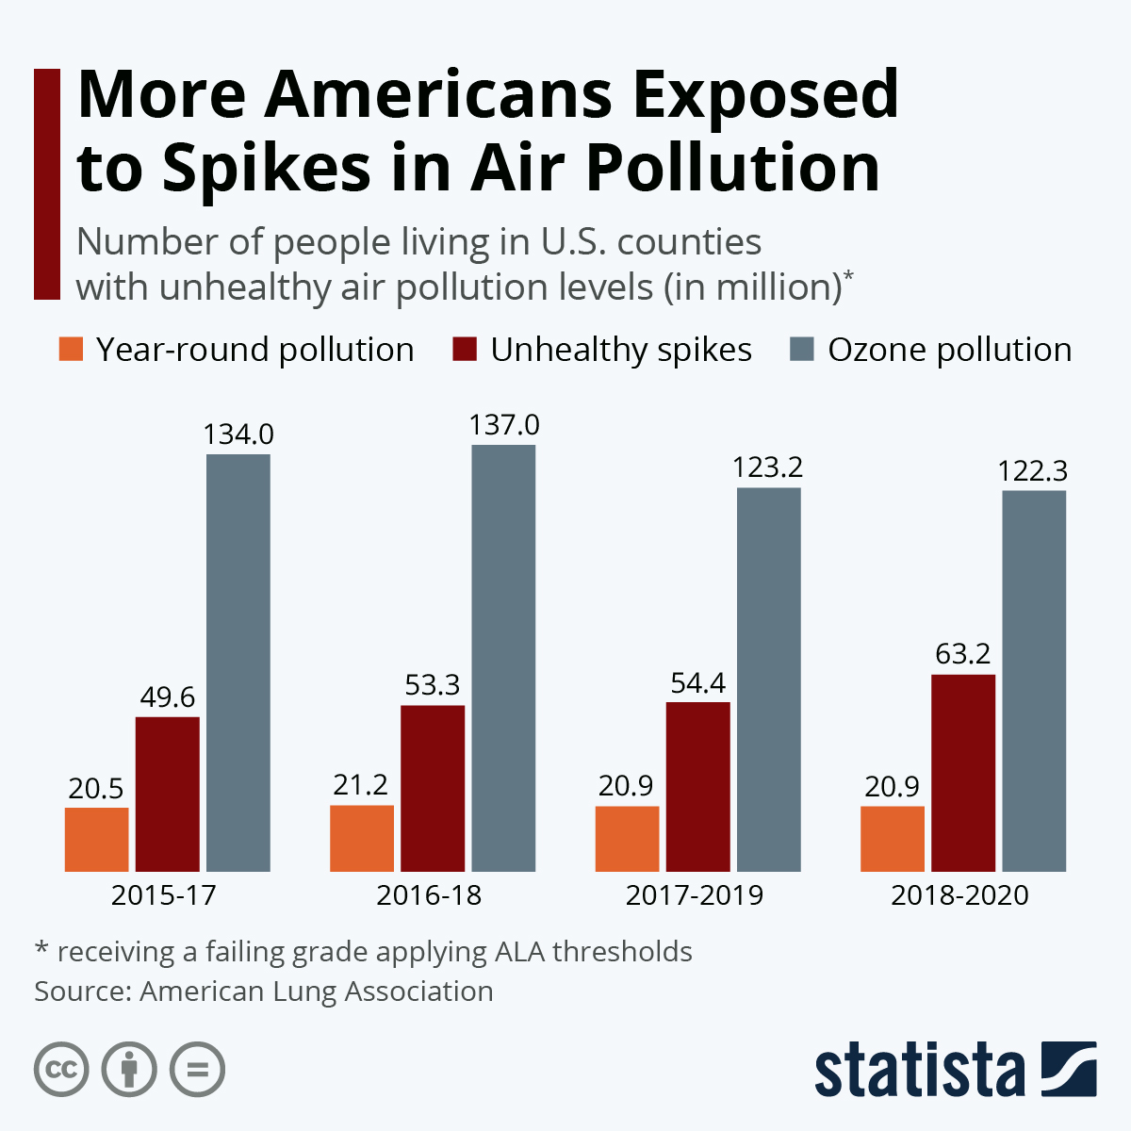
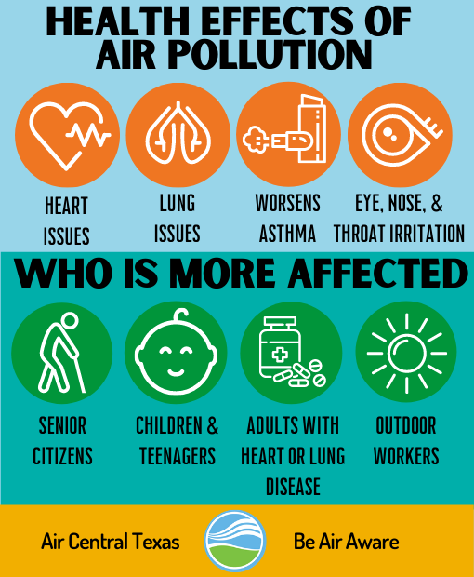
Motivation and why is this relevant?

Slide 4
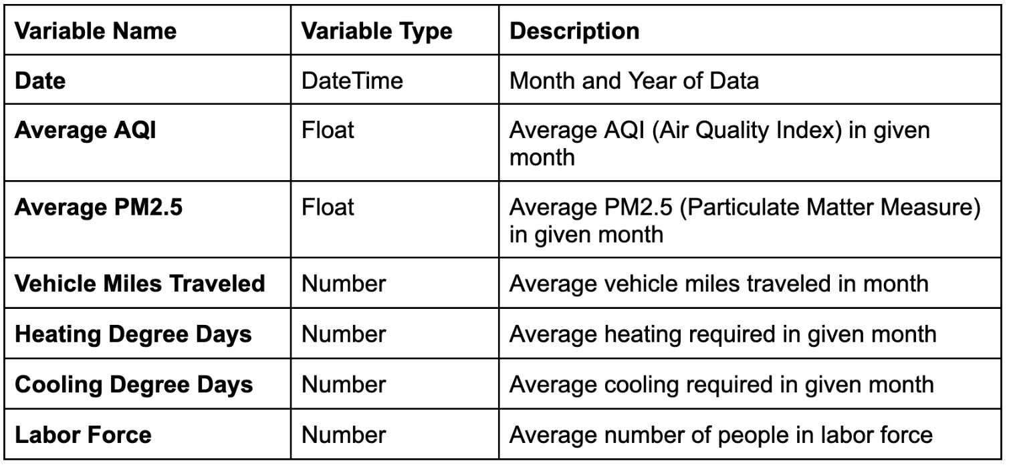
Data Acquisition and Explanation
Source:
AQI: United States Environmental Protection Agency (US EPA)
Vehicles Miles Traveled: St. Louis Fed
Heating and Cooling degree days: National Oceanic and Atmospheric Agency (NOAA)
Labor Force: US Bureau of Labor Statistics
Time Period:
Monthly data from 2010-2023
Total 168 data points
Data Cleaning
Converted daily data to average monthly data
Combined data from multiple sources and excel sheets to single sheet

Slide 5
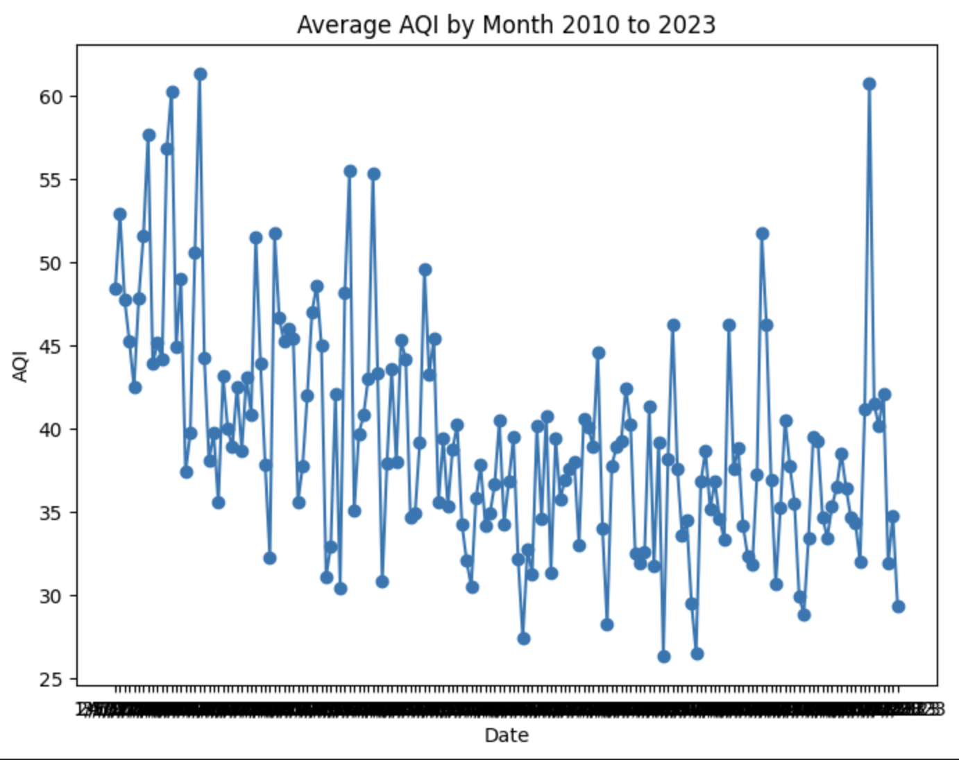
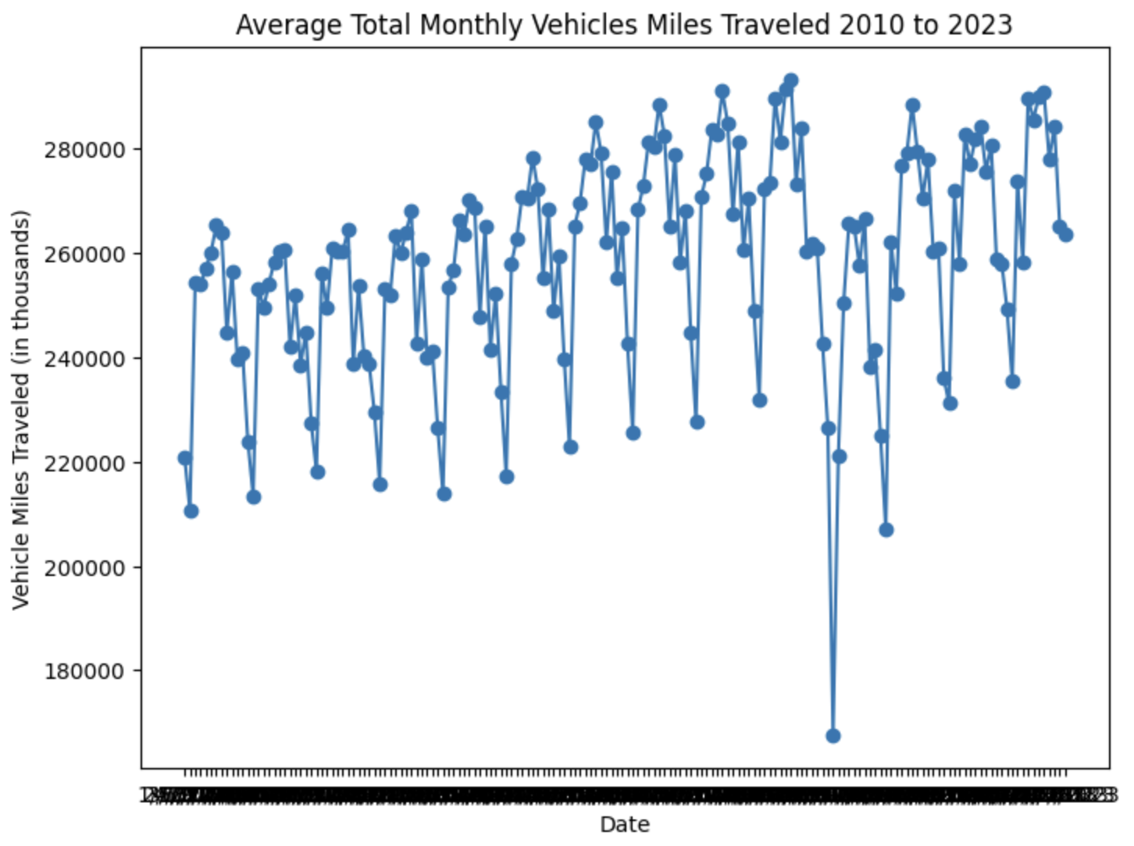
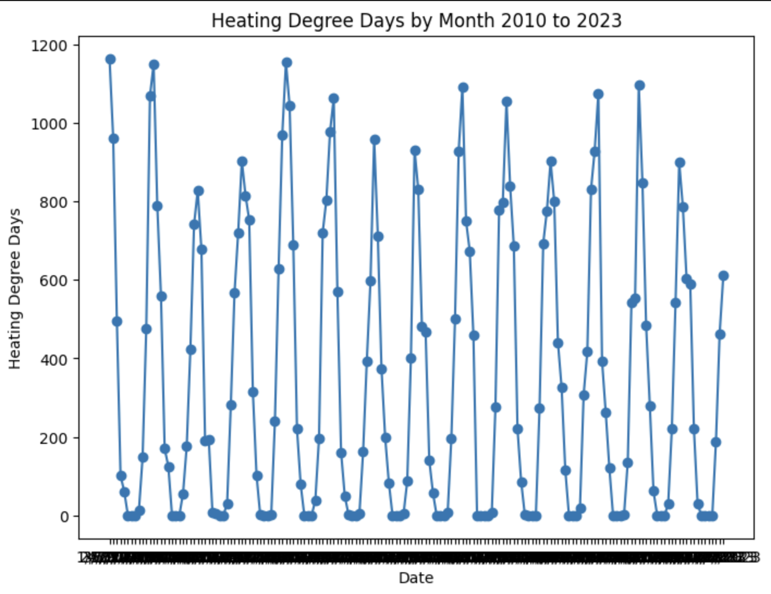
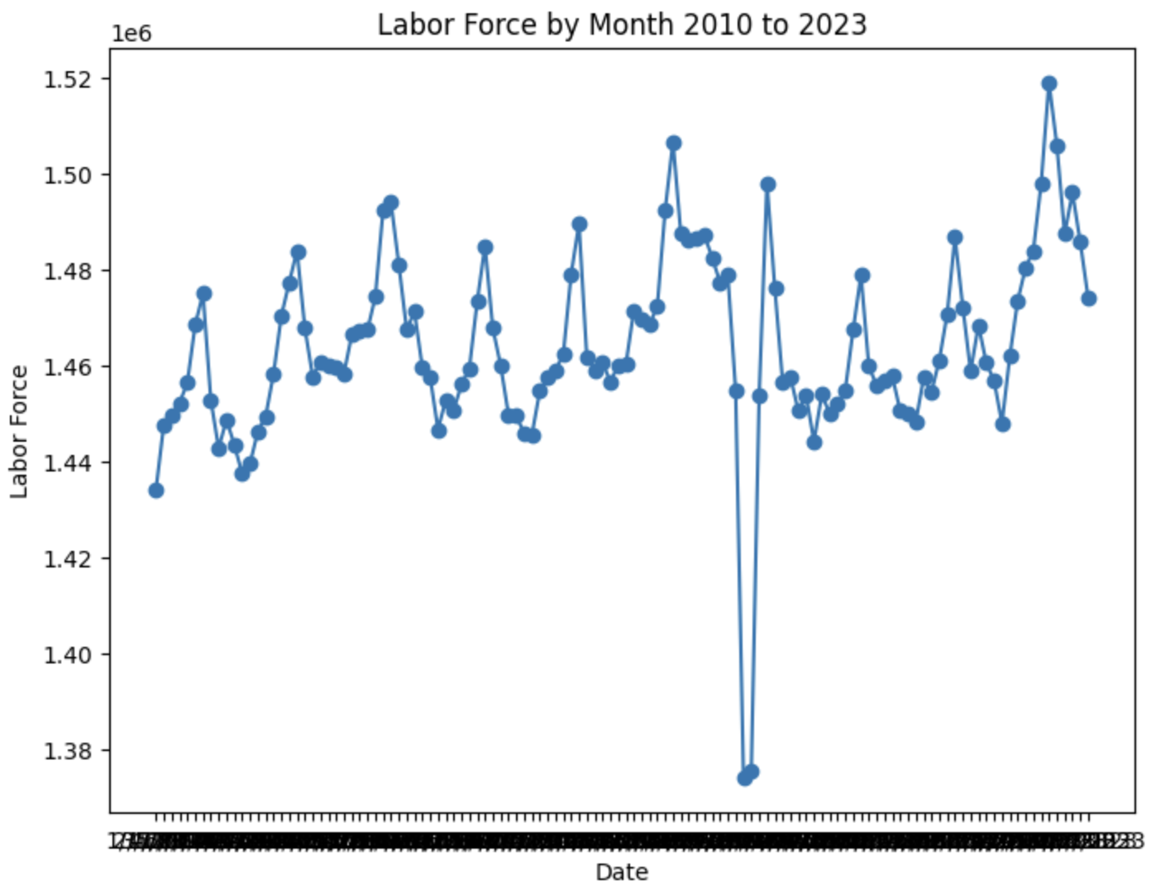
Initial Exploratory Data Analysis
Strong variability across all metrics
Certain factors may move together
Economic forces and seasons likely determinants of trends
Covid-19 impact clearly observable

Slide 6


Analysis Plan
After combining our datasets, we conducted some initial analysis to see initials trends between our variables
Then, we ran a multivariate linear analysis with AQI as the dependent variable and the rest of the variables as dependent variables
Then, we used the ARIMA model to predict future AQI values

Slide 7
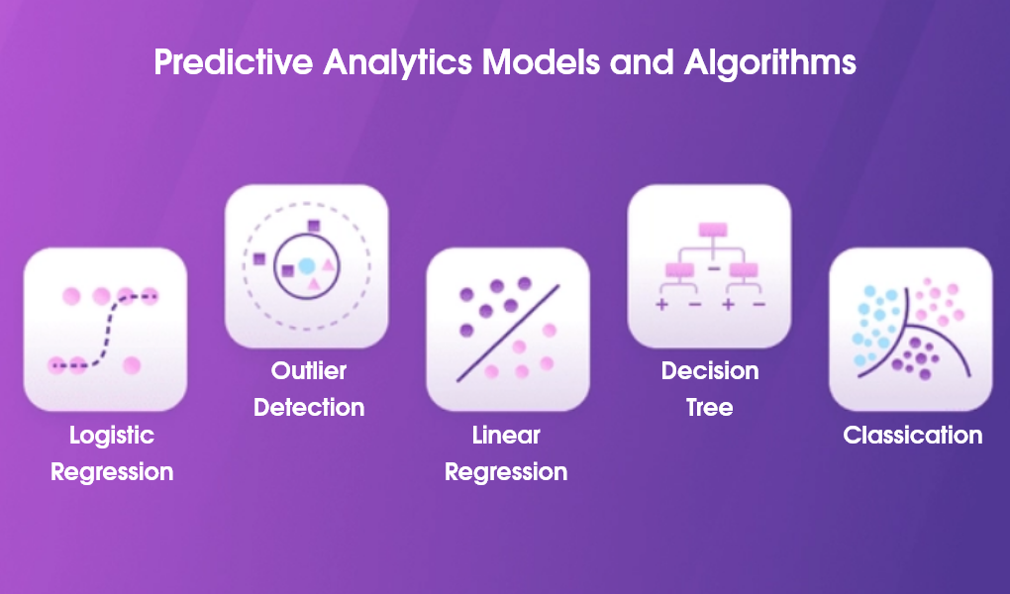
Trick Analysis Decision
Our regression analysis did not produced strong results which made us doubt our model so we decided to calculate the Pearson Coefficient to study the relationship between each independent variable and AQI independently
We weren’t sure if a prediction model would work/be reliable since our regression did not produce expected results

Slide 8

Bias and Uncertainty
A linear regression may not be the most suitable model for our research question and thus might underestimate the effects of the independent variables on AQI
Monthly averages may not accurately reflect changes in daily readings/ overfit our data
Hard to compare daily reading(AQI and Heating and Cooling Degree Days) with monthly data(Vehicle Miles Travelled and Labor Force)
COVID affected different variables differently

Slide 9
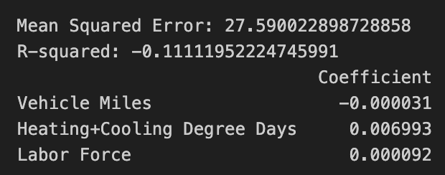
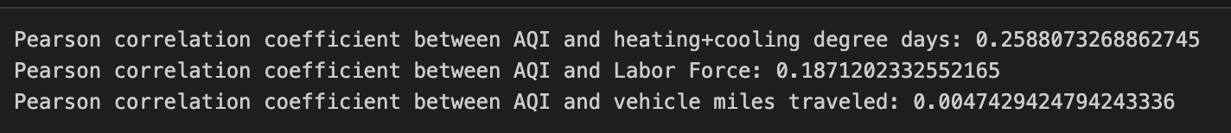
Results and Conclusions: Multi-Linear Regression
Negative and weak R-Squared
Negative coefficient of vehicle miles?
Heating+Cooling Degree Days has largest effect size
Labor Force and Vehicle Miles have minimal impact

Slide 10
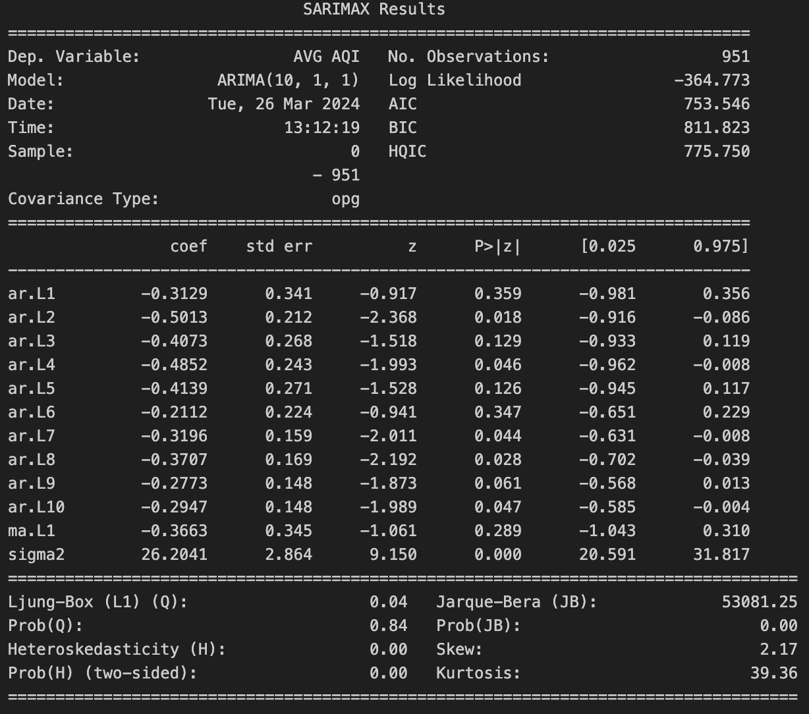

Results and Conclusions: ARIMA Model
ARIMA: Statistical analysis that uses time-series data to better understand data trends, and provide data forecasts
p: number of lag observations in the model (lag order)
d: the degree of differencing (how many times the differencing operation is performed to make data stationary
q: size of the moving average window (moving average order)
Notes:
P: lag observations = previous values in a time series
Q: differencing is a statistical operation to make non-stationary time series data stationary - important because stationary data simplifies the statistical properties (bias, variance) allowing for better modeling/forecasting
Q: helps smooth out fluctuations in data to make forecasts

Slide 11
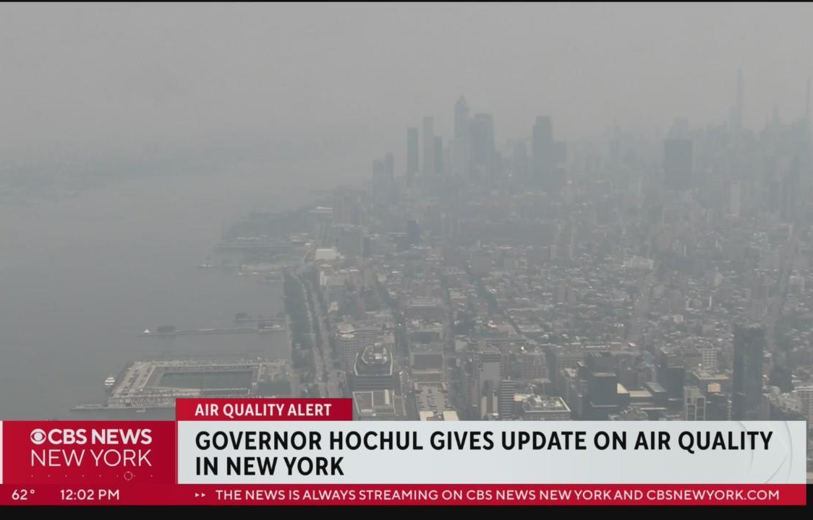
Next Steps
More expansive dataset with a longer time period and daily readings
Expand to larger cities like New Delhi, NYC, and LA where air quality is a huge concern and an analysis like this could influence policy decisions
Conduct non-linear analysis to avoid underestimating effect of independent variables

Slide 12
References
Ellis-Petersen, Hannah. “Delhi Air Pollution Spikes to 100 Times WHO Health Limit.” The Guardian, 3 Nov. 2023, www.theguardian.com/world/2023/nov/03/delhi-india-air-quality-pollution-spike-world-health-organization-limit#:~:text=Delhi%2C%20home%20to%20about%2033.
Hayes, A. (2024, February 23). Autoregressive Integrated Moving Average (ARIMA) Prediction Model. Investopedia. https://www.investopedia.com/terms/a/autoregressive-integrated-moving-average-arima.asp
US EPA,OAR. “Outdoor Air Quality Data | US EPA.” US EPA, 8 July 2014, www.epa.gov/outdoor-air-quality-data.
“Vehicle Miles Traveled.” Stlouisfed.org, 2019, fred.stlouisfed.org/series/TRFVOLUSM227NFWA.
https://www.weather.gov/media/lsx/climate/stl/temp/temp_stl_heating_degree_days.pdf
https://www.weather.gov/media/lsx/climate/stl/temp/temp_stl_cooling_degree_days.pdf
https://www.bls.gov/eag/eag.mo_stlouis_msa.htm

